Slide 1
Evaluating Durability of Cloud Distributed Database: MongoDB Atlas SCDL3991: Science Dalyell Individual Research Project
Presented by
Zachary Jin
Supervisor
Prof. Alan Fekete
Co-Supervisor
A/Prof. Uwe Roehm
Michael Cahill

Slide 2

Background -- MongoDB
MongoDB --- Fault-tolerant NoSQL distributed database
Fault-tolerance: System as a whole keeps working even when a server fails
Replication: Allows fault-tolerance by having multiple copies on different servers
Durability: Data values should remain in the database unless modified by users
It is hard to achieve if a server crashes soon after data is written
MongoDB Atlas: Fully managed MongoDB servers using cloud services
Figure 1. MongoDB Atlas. Adapted from “MongoDB Atlas | MongoDB”. 2020. retrieved from https://www.mongodb.com/cloud/atlas/register

Slide 3
Background -- Cloud Provider
AWS(Amazon Web Service)
A secure cloud services platform, offering cloud computing, database storage and other functionalities
MongoDB Atlas deploys and manages MongoDB servers using AWS virtual machines

Slide 4
Background – Configuration Choices
Read Concern
Local
Majority
Read Preference
Primary
Primary Preferred
Write Concern
Primary
Journaled
Majority

Slide 5
Background -- previous research
Previous Research by Dunn(2018)
Measure performance and durability properties of the different configuration choices, by deliberately causing failures of the servers
Limitation: MongoDB servers were running on 3 virtual machines within a laptop, which is not a realistic cloud setting

Slide 6
Aim
Test and measure performance and durability properties of the different configuration choices in a cloud-based system
Determine whether the conclusion made in the previous research also holds for this cloud-hosted system
Challenges:
MongoDB Atlas is managed by cloud provider, so we can't control failures
How to design a cloud-based system where we can cause failures

Slide 7
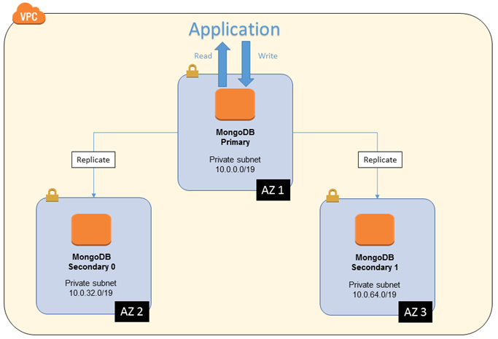
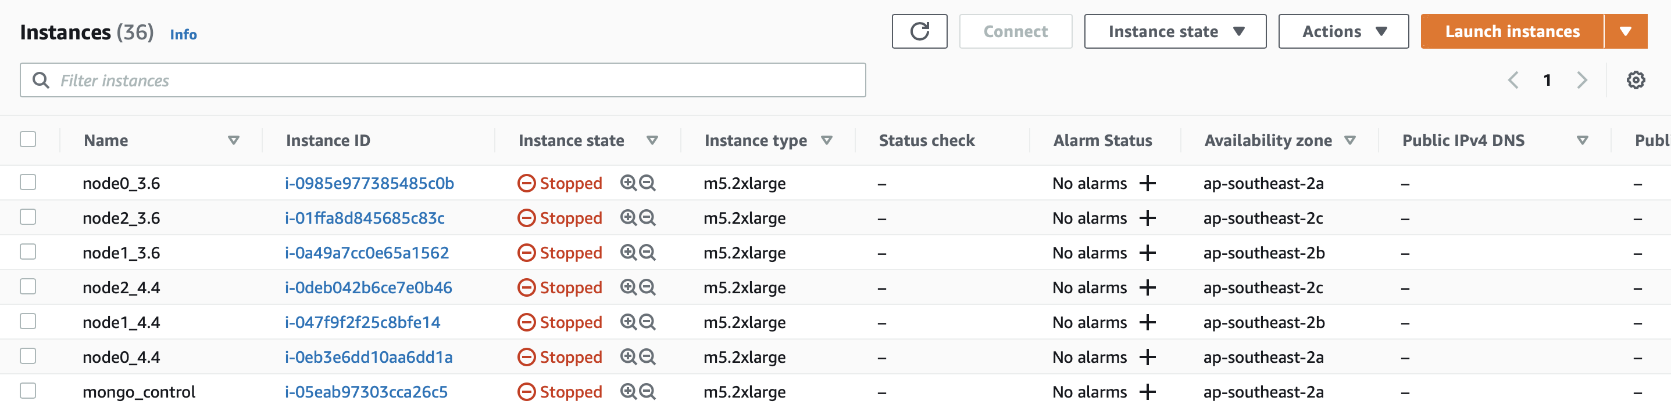
Methods -- Key Idea 1
Set up MongoDB servers in AWS virtual machines
Each machine contains a MongoDB server
3 MongoDB servers can communicate with each other within private subnet(VPC)
Simulate the environment of MongoDB Atlas manually (infrastructure as a service)
Figure 2. Architecture - MongoDB on AWS. Adapted from “Architecture - MongoDB on AWS”. 2020. retrieved from https://docs.aws.amazon.com/quickstart/latest/mongodb/architecture.html

Slide 8
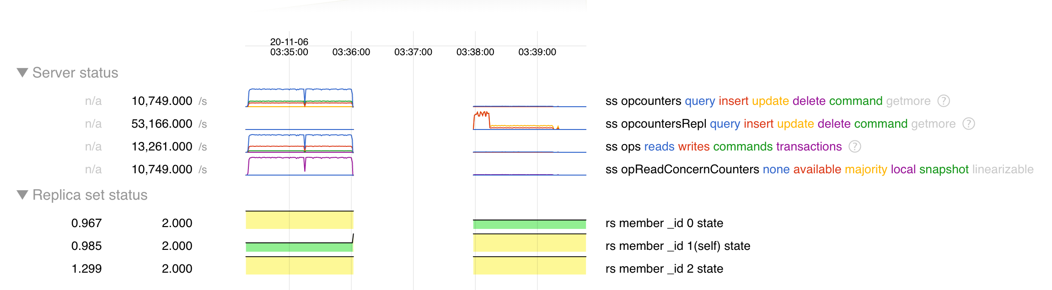
Methods -- Key Idea 2
Use Java API that induces server failures
2 types of server failures: Gracefully ACPI shutdown & Hard Poweroff
Machine status can be monitored through AWS console
(Status changing from running to stopped, and back to running)
Visualise server status in MongoDB data directory

Slide 9
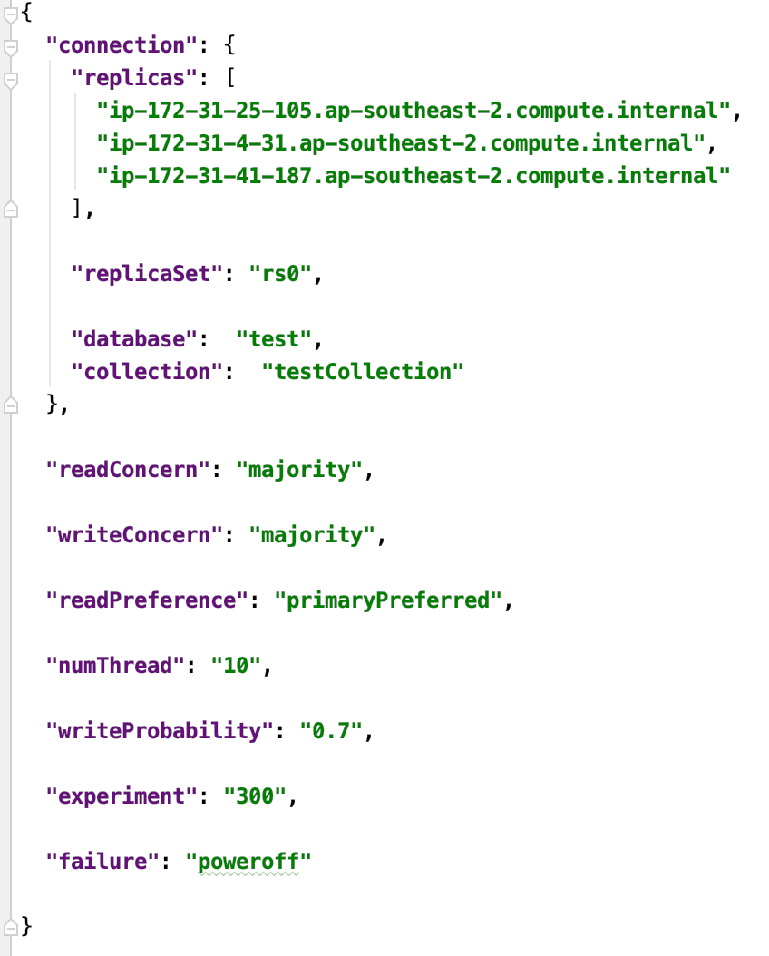
Results -- Measurement Framework
A Java client application
Send data requests automatically to the database in production during the experiment
Collect and sort the execution history for analysis
Conduct the experiment under different configurations and failures

Slide 10
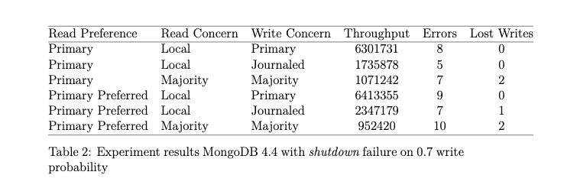
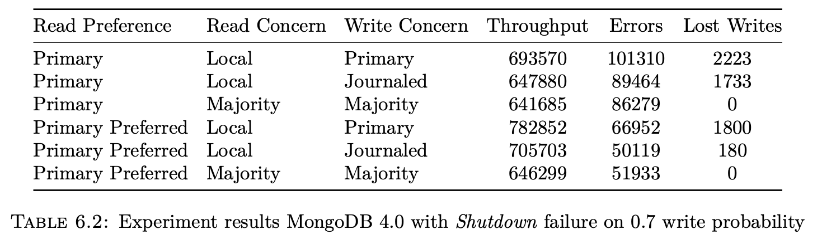
Results -- Performance
The number of throughputs is 10 times as the previous one
Closer to the real production using cloud services
More possible to find out the potential durability issues in real life
Previous research results by Dunn(2018): MongoDB on local virtual machine
Our results: MongoDB on 3 different virtual machine on cloud

Slide 11
Results -- Durability(Surprising)
Lost writes in majority read/write concerns are not expected
As read/write concerns are “majority”, lost writes are expected to be 0
However, non-zero values exist for lost writes in our results
0 Lost writes for other cases
Previous research results by Dunn(2018): MongoDB on local virtual machine
Our results: MongoDB on 3 different virtual machine on cloud

Slide 12
Discussion
Learnt how MongoDB Atlas manages database servers on different machines on cloud
Send shutdown signals to MongoDB remote servers from user sides by Java API
The durability measurement results are not expected. Based on the system structure, non-zero lost writes for read/write majority should be impossible.
More efforts will be paid on researching internal web connections within the servers. There might exists a process for AWS machines that if the acknowledgement message cannot be sent, the data record will not be stored.

Slide 13
Conclusions
Durability of MongoDB servers can be measured in cloud setting, by self-managed servers to which faults are injected through API
The measurement is obtained but is different from the case of setting MongoDB servers on local virtual machines.
Measured loss writes of durability are not aligned with expectations from the previous works on local machines. More researches are needed.
Future Work:
Testing on different versions of MongoDB
Inducing other failures to the cloud servers

Slide 14
References
[1] Dunn, K. (2018). Evaluating Durability of Distributed
Databases: Theory and Empirical Studies of MongoDB, (Unpublished honour thesis), University of Sydney, Australia.
[2] IBM Cloud Education. (2019). DBaaS(Database-as-a-Service). Retrieved November 11, 2020, from https://www.ibm.com/cloud/learn/dbaas
[3] Haerder, T. & Reuter, A(1983). Principles of transaction-oriented database recovery. ACM Computing Surveys, 15(4):287–317. doi: 10.1145/289.291

